Slide 1


Saatvik Sandal
9/4/23

Slide 2

Outline
Executive Summary
Introduction
Methodology
Results
Conclusion
Appendix

Slide 3
Executive Summary
Using the spaceX API, then analysis, visualizations, and models through various technologies, we were able to come up with our answer.
Summary of all results

Slide 4
Introduction
SpaceY is a company like SpaceX that wants to compete with it. The problem we face is that we need to determine what aspects of our company will be draw our customers to us rather than them.
SpaceX advertises Falcon9 launches starting at around 62 million dollars. SpaceY needs to determine the price of each launch and also determine if the first stage will land correctly.

Slide 5

Section 1

Slide 6
Methodology
Executive Summary
Data collection methodology:
Data was collected through the SpaceX API, as well as webscraping from Wikipedia.
Perform data wrangling
The Data was processed in a jupyter notebook using basic analysis tools like pandas and numpy.
Perform exploratory data analysis (EDA) using visualization and SQL
Perform interactive visual analytics using Folium and Plotly Dash
Perform predictive analysis using classification models

Slide 7
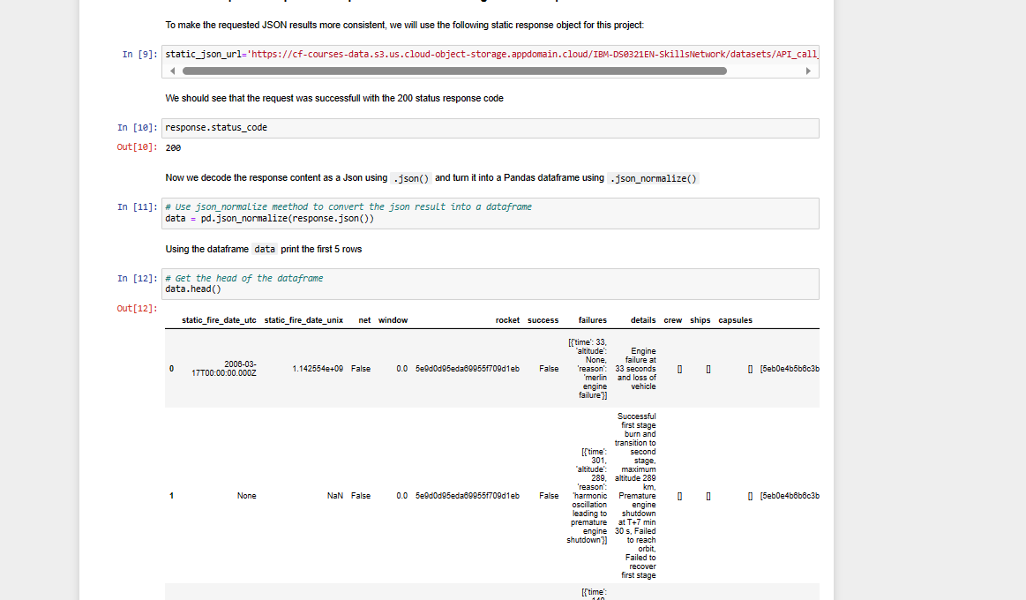
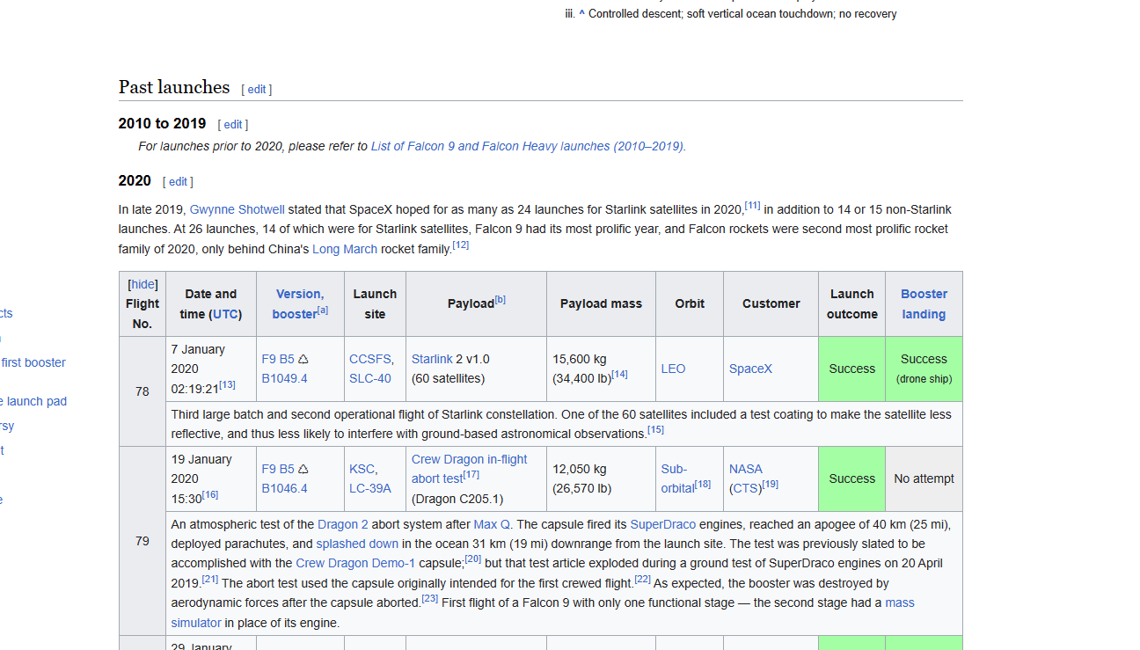
Data Collection
The first method used was to call data from the SpaceX API, and the second using web scraping.

Slide 8
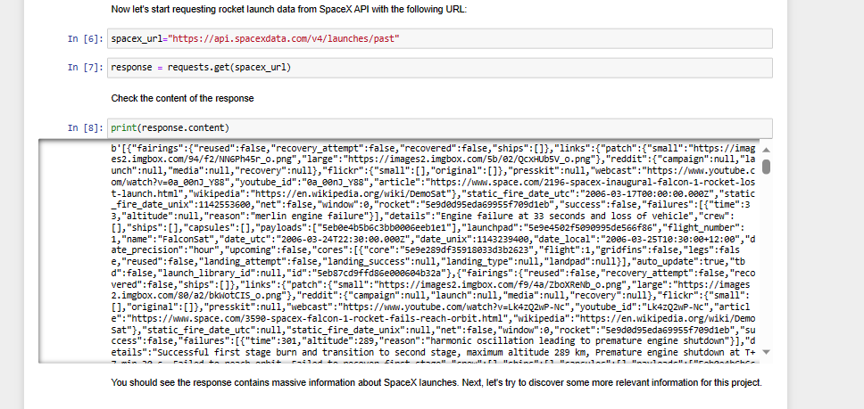
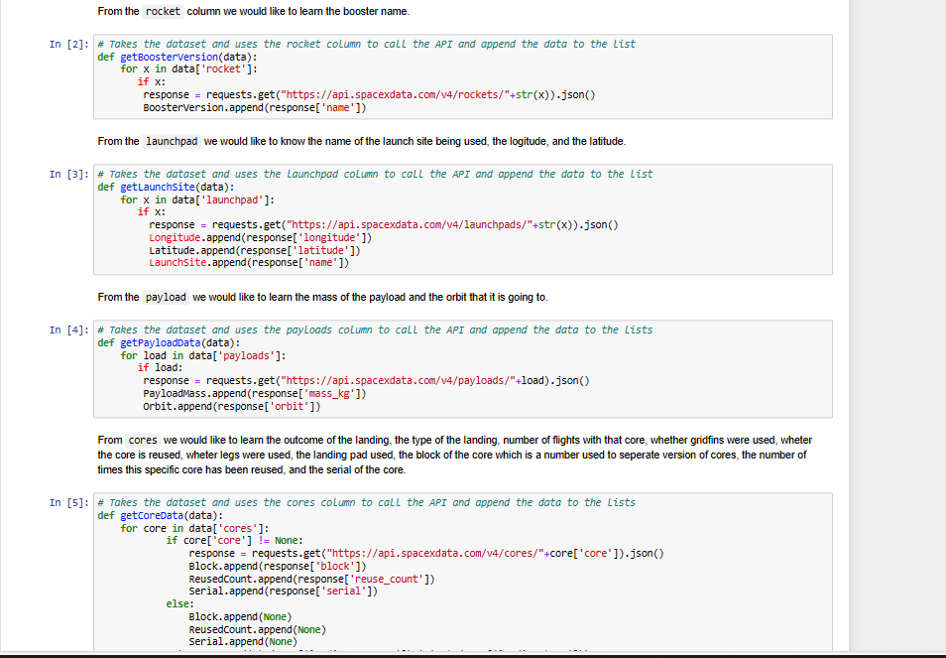
Data Collection – SpaceX API

Slide 9
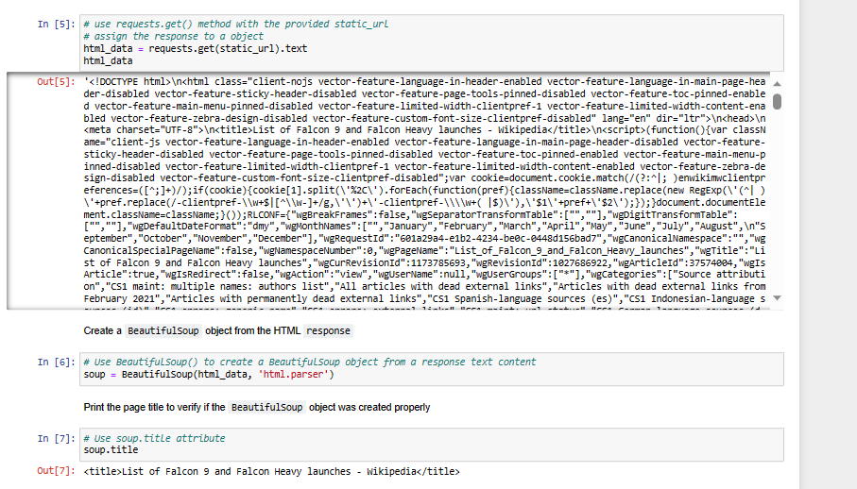
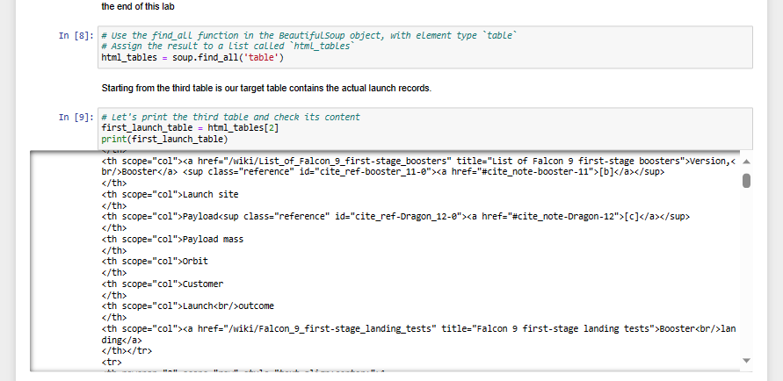
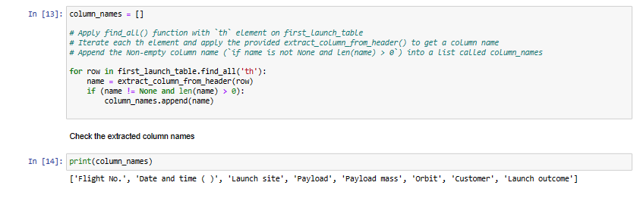
Data Collection - Scraping

Slide 10
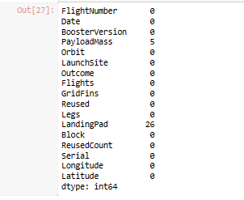
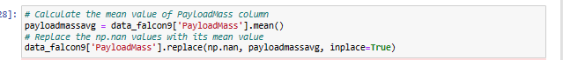
Data Wrangling
First we checked for missing data. When we found those in the Payload mass column all we did was replace them was with the sample mean.
Next we tried to do some basic analysis to get a better understanding of our dataset, such as seeing how launches were conducted to enter ‘x’ orbit and what were their outcomes.

Slide 11
EDA with Data Visualization
List of plots:
Payload Mass vs Launch site
Success rate per orbit
Flight number and orbit
Payload and Orbit
Launch Success Yearly Trend
And more….

Slide 12
EDA with SQL
What we found using database queries:
Found names of launch sites
where launch sites begin with the string 'CCA’
Total mass carried by NASA boosters
Average payload mass in booster version F9 V1.1
List date when the first successful landing outcome in ground pad was achieved
Name of boosters which success in drone ship and had payload mass greater than 4000 but less than 6000.
Success in mission outcomes
Booster Versions
Failed landing outcome details
Count of landing outcomes per outcome.

Slide 13
Build an Interactive Map with Folium
Marked all launchsites on a dynamic map
Assigned launch outcome to different colored markers.
Found distance between launch sites from
Cities
Highways
Railways
Coastlines
A launch site is usually close to all 4 of those points.

Slide 14
Predictive Analysis (Classification)
First we had to prepare our data for modelling.
Then we made models using a mix of supervised and unsupervised models.
Mainly KNN, Decision Trees, SVM, and Logistic Regression.
We used grid search and cross validation for making our models more accurate.
We also used a confusion matrix to identify the accuracy of our models.

Slide 15

Section 2

Slide 16
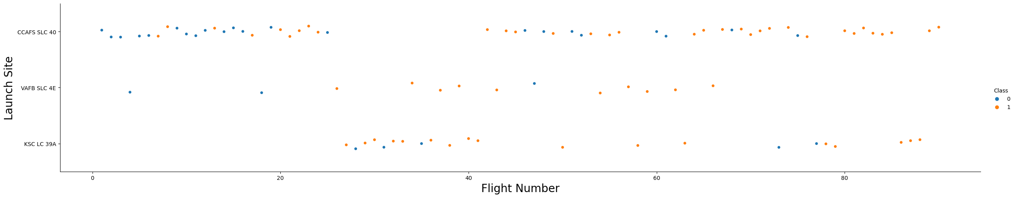
Flight Number vs. Launch Site
Class refers to a successful or failure in launch.
We see that flight number increases success.

Slide 17
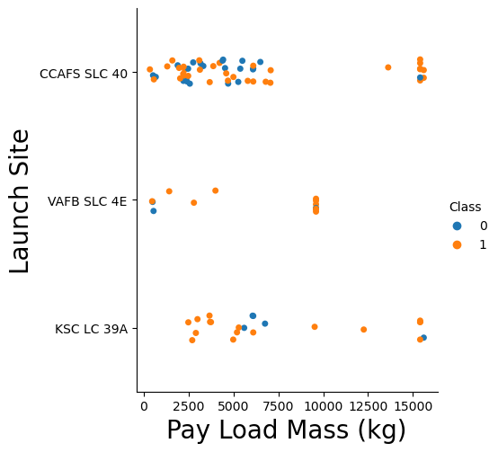
Payload vs. Launch Site
Probability of successful launches only increase at the SCL 40 launch site, with the rest either being maxed out or unclear.

Slide 18
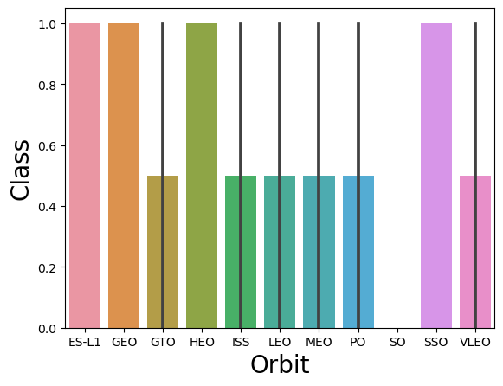
Success Rate vs. Orbit Type
Shows that certain orbits like ES-L1 and SSO have a high success rate while others like SO and GTO do not.

Slide 19
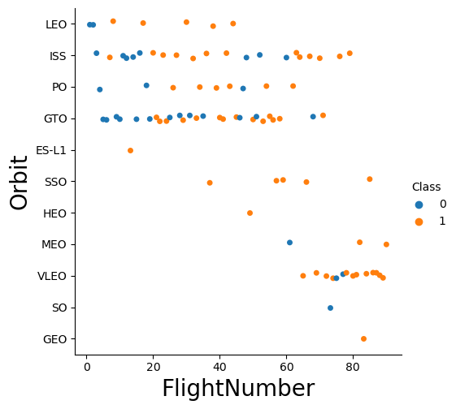
Flight Number vs. Orbit Type
Some orbits do not seem to have any correlation, and some do not contain enough data.

Slide 20
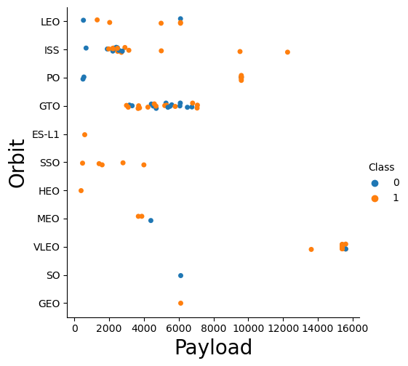
Payload vs. Orbit Type
Some orbits will only have large payloads like VLEO, while others only small like SSO, and some will not have enough information.

Slide 21
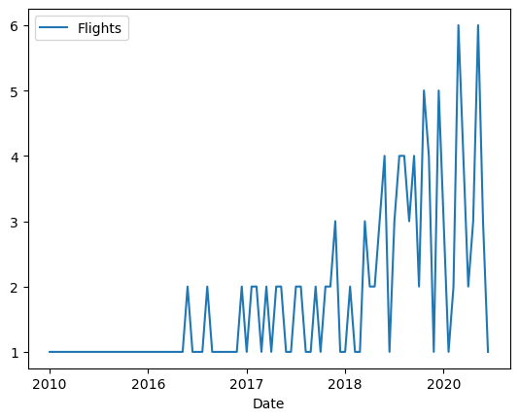
Launch Success Yearly Trend
We can see that the general success of flights over the years has been steadily increasing.
Means that there is less room for error.

Slide 22
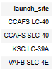
All Launch Site Names

Slide 23
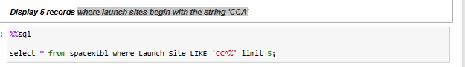
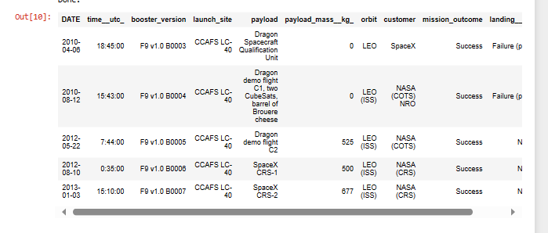
Launch Site Names Begin with 'CCA'

Slide 24
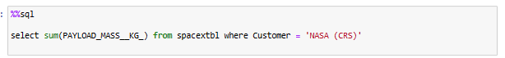
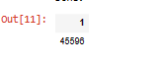
Total Payload Mass

Slide 25
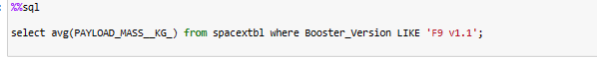
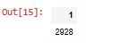
Average Payload Mass by F9 v1.1

Slide 26
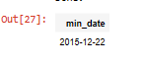
First Successful Ground Landing Date

Slide 27
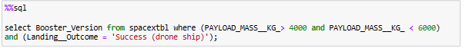
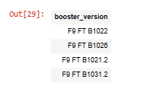
Successful Drone Ship Landing with Payload between 4000 and 6000

Slide 28
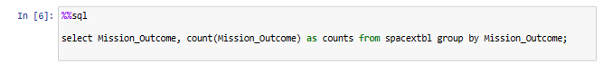
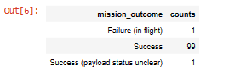
Total Number of Successful and Failure Mission Outcomes

Slide 29
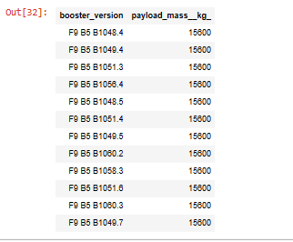
Boosters Carried Maximum Payload
%%sql
select Booster_Version, PAYLOAD_MASS__KG_ from spacextbl where PAYLOAD_MASS__KG_ = (select max(PAYLOAD_MASS__KG_) from spacextbl);

Slide 30
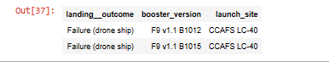
2015 Launch Records
%%sql
select Landing__Outcome, Booster_Version, Launch_Site from spacextbl where Landing__Outcome = 'Failure (drone ship)' and year(Date) = '2015'

Slide 31
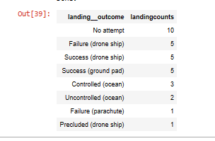
Rank Landing Outcomes Between 2010-06-04 and 2017-03-20
%%sql
select Landing__Outcome, count(*) as LandingCounts from spacextbl where Date between '2010-06-04' and '2017-03-20'
group by Landing__Outcome
order by count(*) desc;

Slide 32

Section 3

Slide 33

<Launch Site Labels:>
Launch Site Labels:

Slide 34
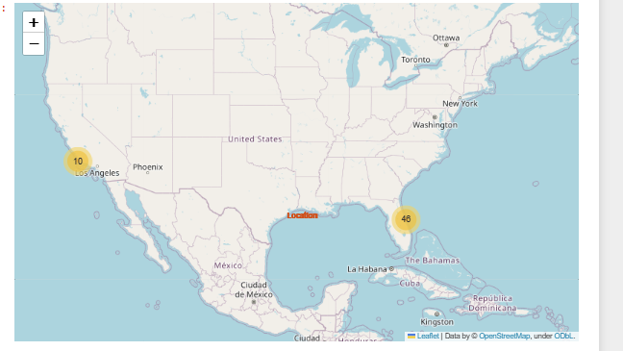
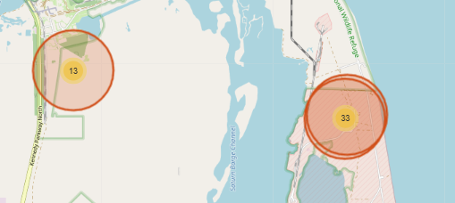
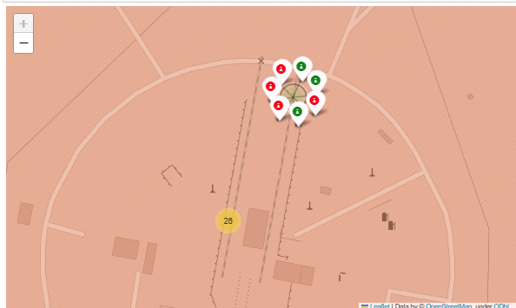
Success and Failed Launches Per Site

Slide 35
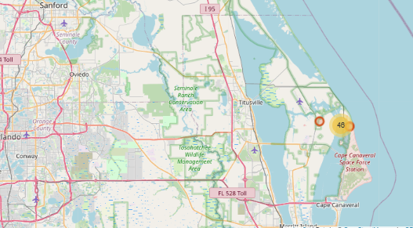
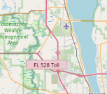
Distances between a launch site and infrastructure

Slide 36

Section 5

Slide 37
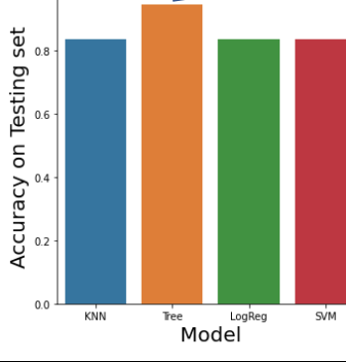
Classification Accuracy
All models were relatively similar in accuracy, with the predictive tree being the best.

Slide 38
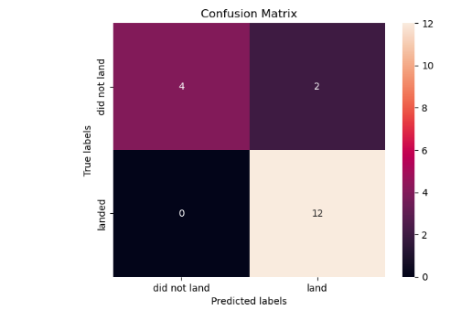
Confusion Matrix
This model correctly found that 4 out of 6 did not land, and correctly found that 12/12 landed, which is impressive accuracy.

Slide 39
Conclusions
We created a model that has an overall accuracy of 88%, and correctly predicted all of the landings in the test sample.
We have found that there is a negative correlation between increasing payload and increasing chances of success.
SpaceX has been increasing their accuracy rate since inception, and shows no sign of slowing down.
Both launch site and orbit has a significant impact on the probability of success, so choose wisely.

Slide 40
Appendix
Database used was IBM db2 database.
For All Notebooks and datasets used please visit Saatvik1 (github.com)

Slide 41


